Slide 1
Multi-threaded Web Crawler
Nayyara Naseer & Tatheer Zahra

Slide 2
Contents
Problem Statement
Proposal
Background Research
Innovation
Work Division
Limitations
Future Development
Implementation
Explanation
Tools & Programming Language
Outputs
Development
Comparison with existing solutions
Major Problems

Slide 3
Problem Statement
Need to have a mechanism or application which crawls through and indexes the data of different webpages in order to find relevant and useful information
However, this needs to be designed in a way which is very efficient, time-saving, and resource-effective.

Slide 4

Proposal
A GUI-based web-crawler that crawls through different webpages and gathers data efficiently by employing a combination of the most appropriate and relevant data structures and programming technologies.

Slide 5
Background Research
Web-crawlers were first invented to perform specific tasks such as providing statistics and indexing only.
We currently use second generation web-crawlers.
Web-crawlers started as simple programs to skim data but now known as spiders, play a huge role in Search Engine Optimization (SEO).
Requirements to make a crawler:
Knowledge of web-scraping
Database to store and retrieve indexed data
Should be extensible
Written with libraries that are portable

Slide 6
Background Research
Research papers consulted:
Bry, F. Web Crawler for social network user data prediction using soft computing methods. International Journal of Computer Science and Information Technology ( IJCSIT )
Jain, S. (2018). A Methodical Study of Web Crawler. VandanaShrivastava Journal of Engineering Research and Application
Ackyaol, M., Baker, M. (2017). Priority Queue Based Estimation of Importance of Web Pages for Web Crawlers. International Journal of Electrical and Computer Engineering

Slide 7
Tools and Programming Language
Oracle VM Virtual Box
Ubuntu 14.04
C/C++

Slide 8
Innovation
Built the web-crawler from scratch
Used our own, unique combination of data structures to achieve efficiency
Used arrays for faster random access and better cache locality
Used linked lists for their dynamic size and more memory-efficient implementation of priorities
Implemented the program in C++

Slide 9
Development
Built the logic
Integrated Priority Queues
Created the GUI
Implemented File Handling
Structure Arrays in C
Shifted to C++ for linked lists

Slide 10
Implementation
Use of multiple data structures:
Structure Arrays
Priority Queues via Linked Lists
Multi-threading
Synchronisation
File Handling
Time elapsed calculation
Checks for error handling
Graphical User Interface (GUI) based solution

Slide 11
Major Problems Encountered
Segmentation Fault
Limitations of C programming language
Extracting data from files
Implementing nesting in priority queues

Slide 12
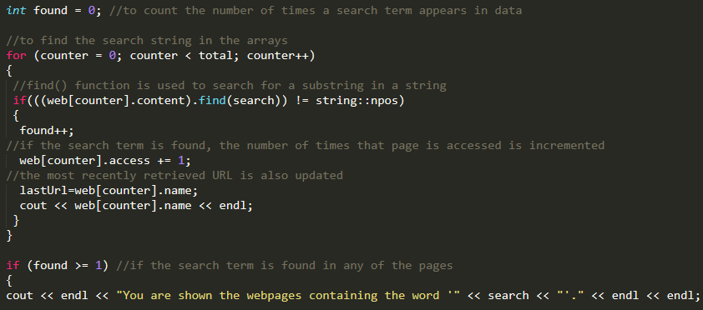
Explanation
Finding a match for the input string

Slide 13
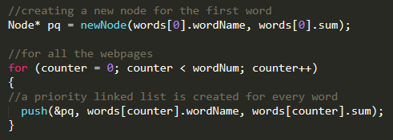
Explanation
Creating a priority queue via linked list

Slide 14
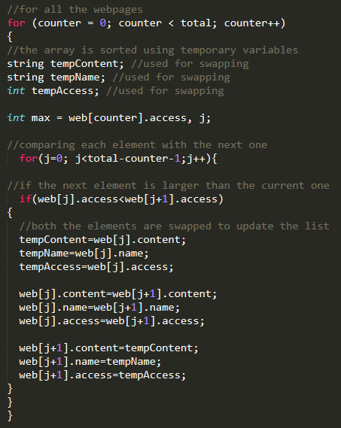
Explanation
Updating the
priorities per each
search

Slide 15
Explanation
//initialising the GUI GTK program
gtk_init(&argc, &argv);
//creating a GUI window
window = gtk_window_new(GTK_WINDOW_TOPLEVEL);
//setting window size and position
gtk_window_set_default_size(GTK_WINDOW(window), 1000, 1000);
gtk_window_set_position(GTK_WINDOW(window), GTK_WIN_POS_CENTER);
//adding buttons to the window
GtkWidget *display7 = NULL;
display7=gtk_button_new_with_label("Most searched word");
gtk_table_attach_defaults(GTK_TABLE(myTable), display7,0,1,4,5);

Slide 16
Comparison with existing solutions
Our Solution | Existing Solution
Built in C++ | Built in Python, Java, HTML
Implemented using a combination of arrays, queues, and linked lists | Implemented using heaps and binary trees
Faster traversal through the data | Slower traversal through the content
Additional capabilities due to multiple data structures | Limitations of a single data structure
Efficiently utilises time and resources | Time and resource consuming

Slide 17
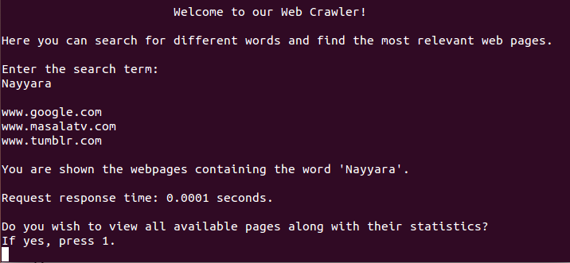
Outputs (i)

Slide 18
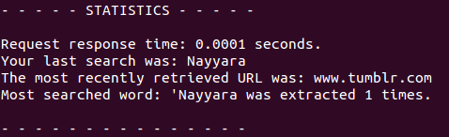
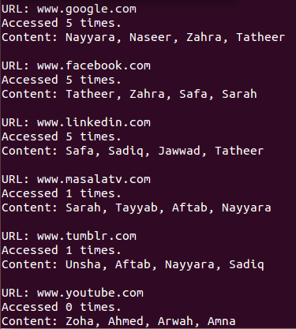
Outputs (ii)

Slide 19
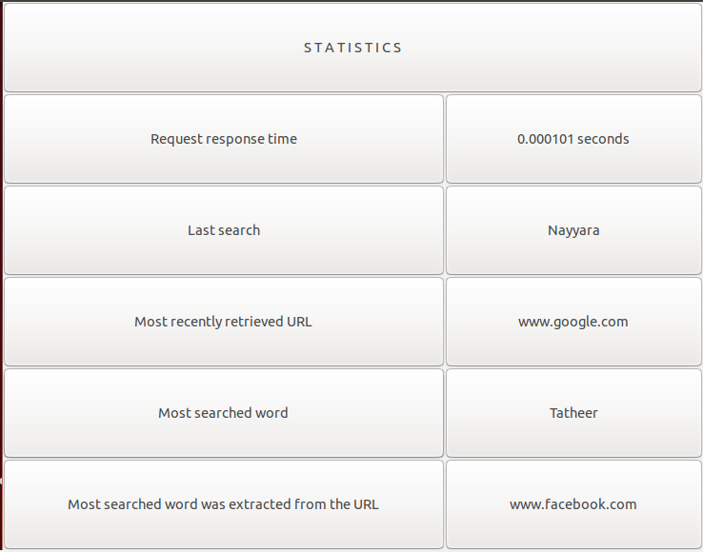
Outputs (iii)

Slide 20
Work Division
The entire project was done together.
Errors were handled separately.

Slide 21
Limitations
GUI-based solution can only be viewed after the main program quits; hence, the last result is shown only.
Limited data to crawl through.
Hard-coded data rather than data retrieved from online sources.

Slide 22
Future Development
Implementation of multiple threads to crawl different parts of a webpage.
Nesting within the priority queues.
Catering to different combinations of words instead of a single string only.
Data of each file to be stored in a new file to allow for a more extensive program.

Slide 23
Discussion & Questions

